Slide 1
Bond investment strategy
Alper YILDIRIM

Slide 2
Contents
Global Market Outlook
Portfolio Distribution
Portfolio Construction
Risk Considerations
Interest Rate Risk
Laddering
Strategy
Inflation Risk
Credit Risk
Inflation Risk
Geopolitical Risk
Global Diversification
CDS/Yield Arbitrage

Slide 3
Portfolio constructıon

Slide 4
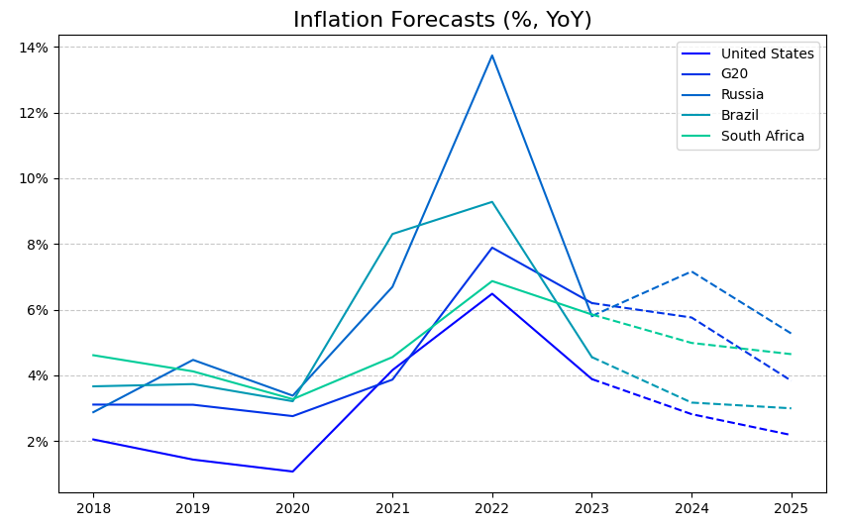
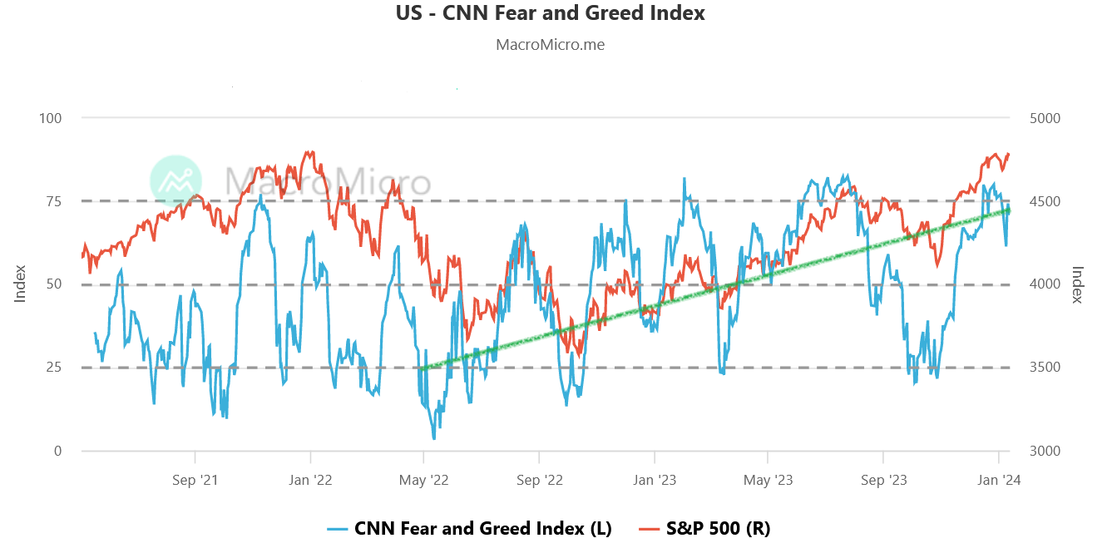
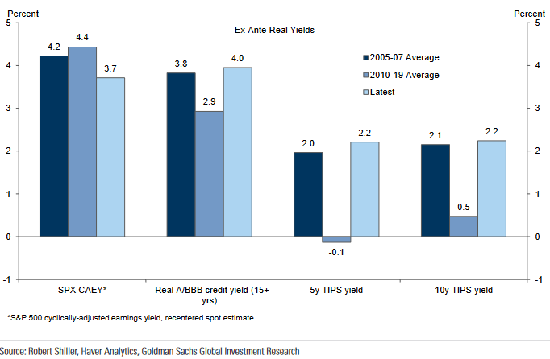
Global market outlook

Slide 5
PORTFOLIO DISTRIBUTION
 | YTM | Price | Maturity | Cpn | Rating
Bond 1 |  |  | 1 |  | AAA
Bond 2 |  |  | 1 |  | AA
Bond 3 |  |  | 1 |  | AA
Bond 4 |  |  | 2 |  | BBB
Bond 5 |  |  | 2 |  | AAA
Bond 6 |  |  | 5 |  | AA
Bond 7 |  |  | 10 |  | BBB
Bond 8 |  |  | 30 |  | BBB
Bond Selection Criteria:
Geographical Diversification
Laddering for Risk Aversion
High Cpn Rate
Summary:
60% US Treasuries
Rating Distribution: AAA : 40% BA : 30%
Portfolio Duration:
DV01:

Slide 6
strategy

Slide 7
Strategy
No “callable” and “putable” bonds
Anticipating interest rate cuts after 2024Q2
“callable”: cheaper re-financing for issuers → increasing call risk
“putable”: declining rates → less value of put option

Slide 8
RISK CONSIDERATIONS

Slide 9


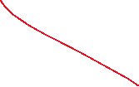



Interest rate rısk
Portfolio has:
Macaulay Duration:
Modified Duration:
Convexity:
DV01:.

Slide 10
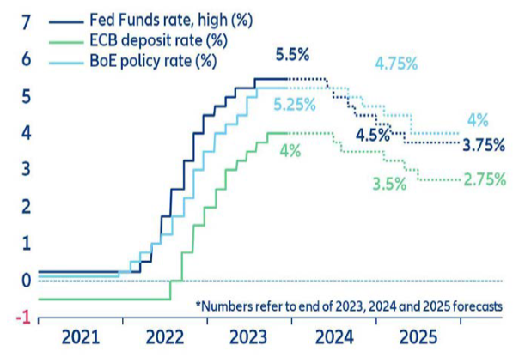
Inflatıon and interest rate rısk
Even though risks persist, inflation started to cool down
Following 2024Q2, interest rate cuts may start
Data Source: OECD Economic Outlook, November 2023
Source: Allianz SE, Global Economic Outlook 2023-25

Slide 11
Lıquıdıty rısk

Slide 12
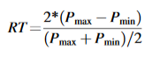
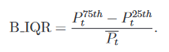
LIQUDITY RISK MEASURES
Given the cross-sectional nature of data, the liquidity proxy is: Bid-Ask Price Difference
If high-frequency time series data is available:
Roundtrip (Feldhütter (2012))
Inter-Quartile Range (Han and Zhou (2007))
Roll (Friewald, Jankowitsch, and Subrahmanyam (2012))

Slide 13
Credıt rısk

Slide 14
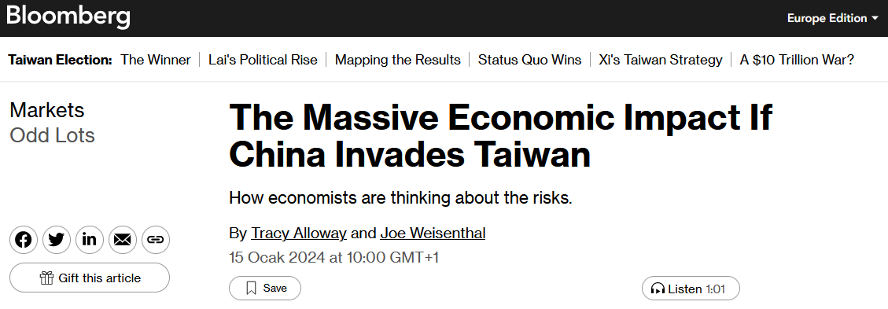
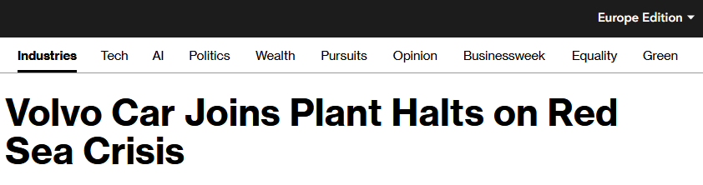
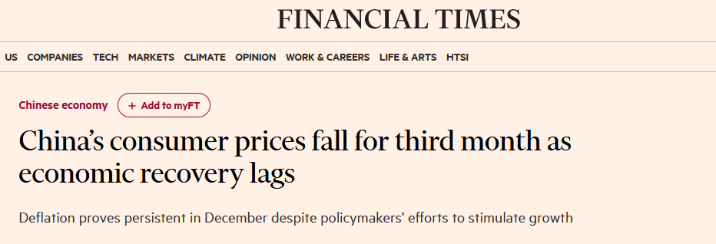
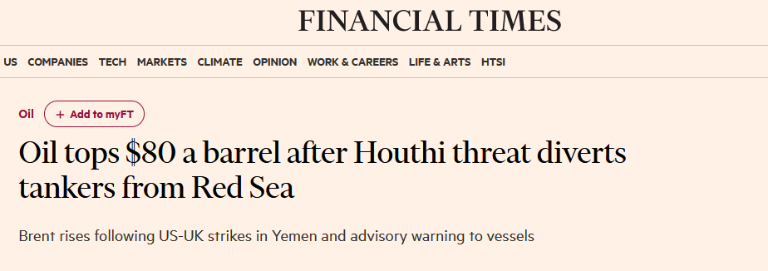
Geopolıtıcal rısk
Avoid Chinese and Middle East Region bonds
Rising political and military tensions may eventually lead economic downturn and declining markets

Slide 15
THANK YOU
Alper Yıldırım
yildirimalper@outlook.de

